Slide 1
World Wide Importers
Get to know the business insights

Slide 2
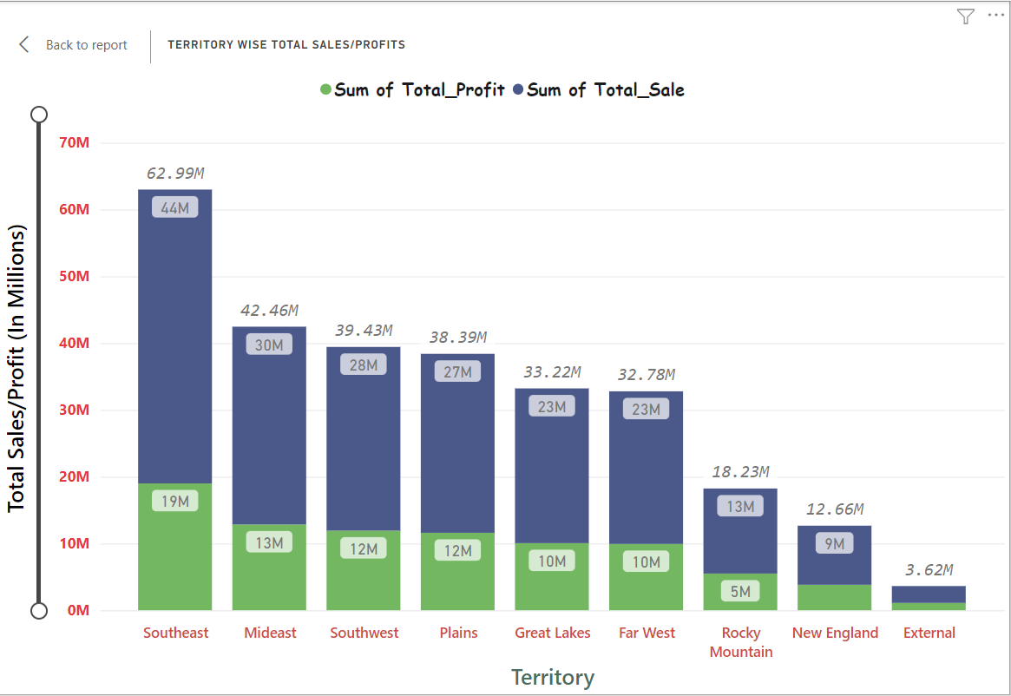
Territory wise Sale/Profit

Slide 3
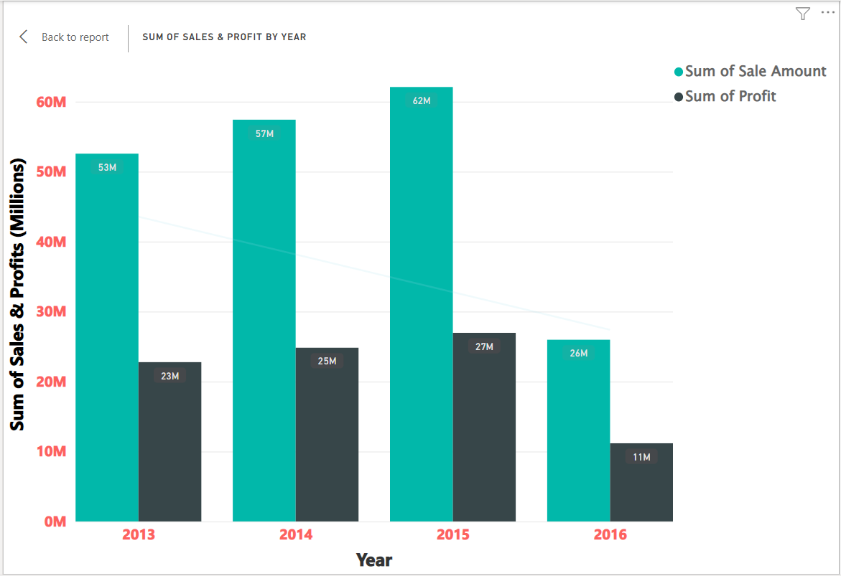
Year wise Sales/Profits

Slide 4
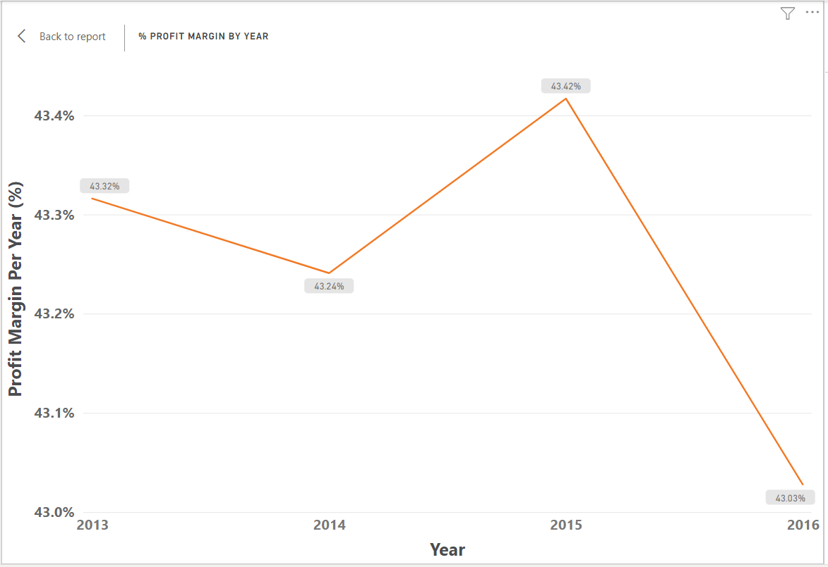
Profit Margin(%) since 2013

Slide 5
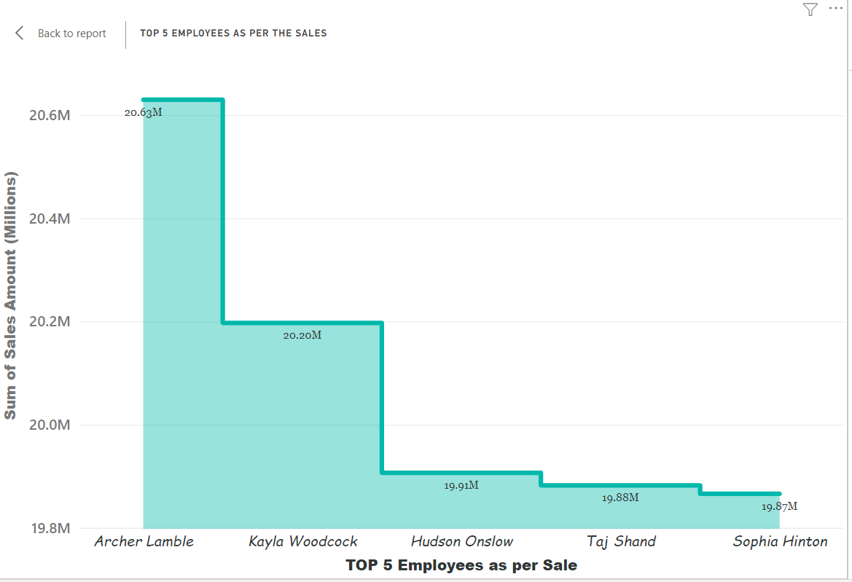
Top 5 employees as per Sale

Slide 6
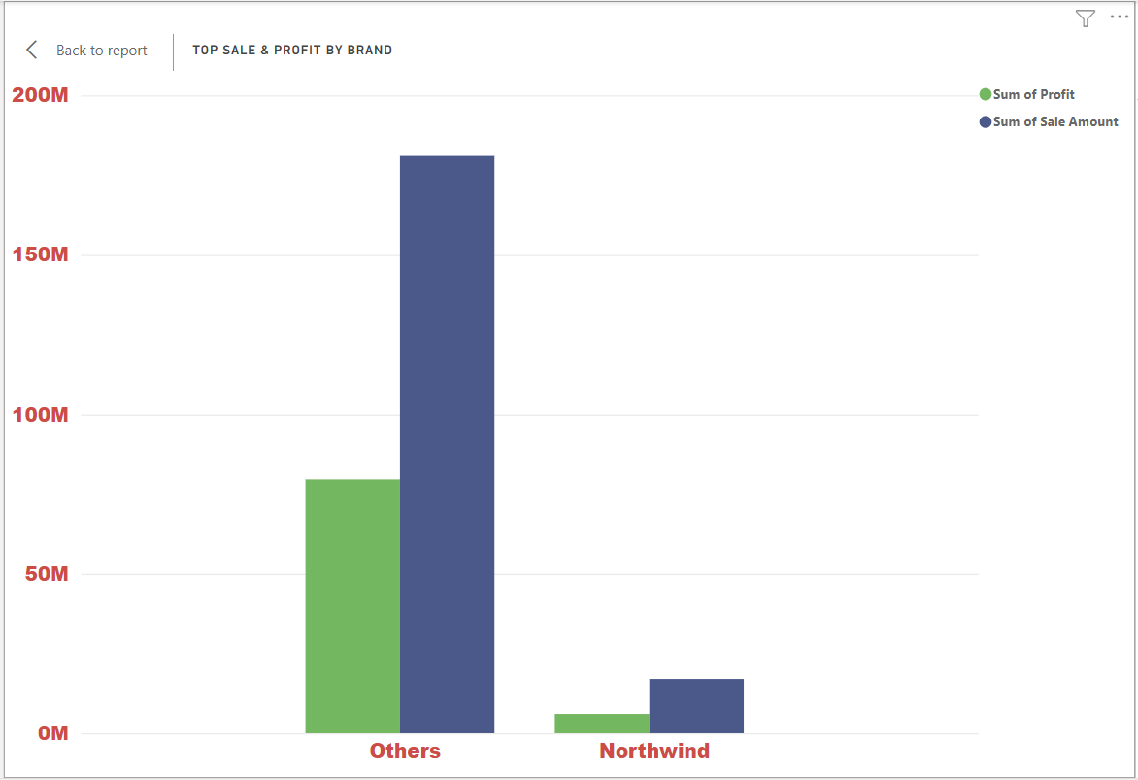
TOP 2 sales as per Brand

Slide 7
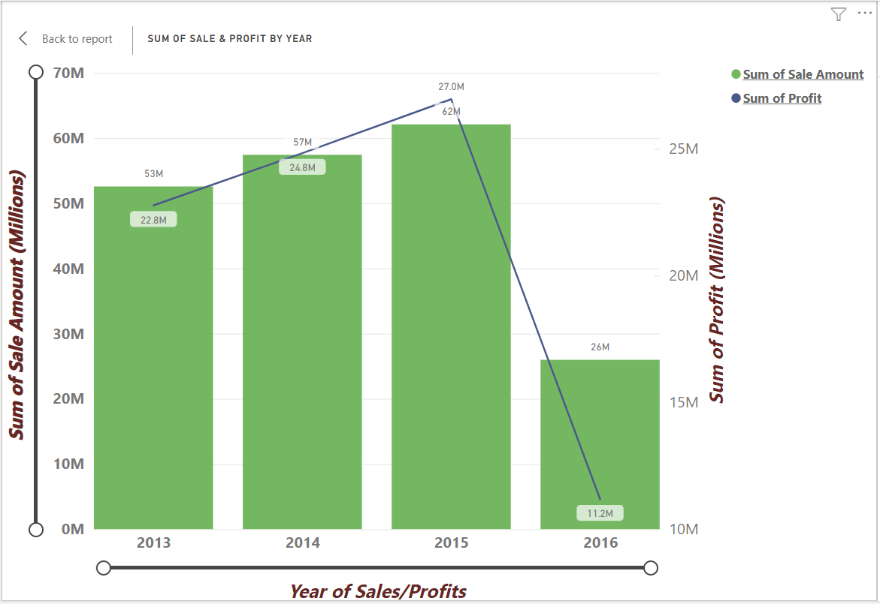
Correlation of Profit/Sale by Year

Slide 8
Forecasts for upcoming Sales/Profits
As per the observation of current data, profit might decrease because customers are not getting the interesting deals that could attract them towards the present products.
Since 2013 Sales might increase or decrease but it is impacting the profit in decreasing trend.
The options are minimal as customer have to deal with limited number of brand.
In coming years, sales might not impact in decreasing trend but it will not give much profit to employees as in the absence of more options, customer will not buy the products at higher price

Slide 9
Recommendations
Importers need to provide more attractive offers to customers which could be such as discounts, brand options etc.
Need to approach more customers.
Need to deal in more big bunch according to price tier.
High level of categorization might help to achieve the more profit.
Sales need to increase in below areas/territories
External
New England
Rocky Mountain

Slide 10


Slide 11


